Slide 1



Digital Electronics

Slide 2


CHAPTER-1
Fundamentals of Digital Systems and Logic Families

Slide 3
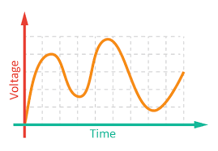
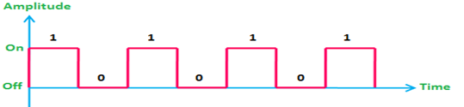
Digital Signal
Signal: A physical quantity, which contain some information and which is function of one or more variables.
Type of Signal:
  Analog Signals
  Digital Signals
Analog Signals: Signal having continuous values and infinite number of different values.
Examples: Things observed in nature are analog like Temperature, Pressure, Distance, Sound and Current.
Digital Signals: Signal which has only a finite number of distinct values.
Examples: Signals obtained directly from computers, Output of A to D converter.

Slide 4



Digital Circuits/Systems
Digital circuits have input signal and output signal both are digitals.
Digital Computer Digital Television Traffic Control System

Slide 5
Number Systems
Sets of values used to represent quantity like number of students attending classes, Grades archived by students in tests.
Various Number Systems:
Name of Number system | Base (radix-r) | Number of Digits (r) | Largest value of Digit (r-1) | Weight value (r) | Range (0 to r-1)
Binary | 2 | 2 | 1 | 2 | 0,1
Octal | 8 | 8 | 7 | 8 | 0-7
Decimal | 10 | 10 | 9 | 10 | 0-9
Hexadecimal | 16 | 16 | 15 | 16 | 0-9, A-F

Slide 6
Number System Conversion
Conversion from any radix to Decimal:
  Note down given number.
  Write the weight of different positions.
  Multiply each digit with corresponding weight to obtain product numbers.
  Add all product numbers.

Slide 7
Number System Conversion
  Conversion from Decimal to other radix:
  Separate integer and fractional parts.
  For Integer part:
      Divide the integer by the base until there is nothing to left.
      Keeping track of remainders from each step.
      List the remainder values in reverse order to find the equivalent.
  For Fractional part:
    Multiply the fractional part by the radix(r).
    Record the carry generated in this multiplication as MSD.
    Multiply only the fractional part of product in step-2.
    Repeat step-2 and 3 up to end. Last carry will represent the LSD.
  Combine result of Integer part and Fractional part.

Slide 8
Number System Conversion
Conversion from Binary to Octal:
  Group the binary bits into groups of 3 starting from LSB.
  Convert each group into its equivalent octal.
Conversion from Binary to Hex:
  Break the binary number in to 4-bit sections from LSB to MSB
  Convert each 4-bit binary number into hex equivalent.
Conversion from Octal to Binary:
  Convert each octal digit into its equivalent 3-bit binary number.
Conversion from Hex to Binary:
  Convert each hex digit to its 4-bit binary equivalent.
  Combine the 4-bit sections by removing the spaces.

Slide 9
Number System Conversion
Conversion from Octal to Hex:
  Convert the given octal number into equivalent binary.
  Then convert this binary number into hex.
Conversion from hex to Octal:
  Represent each hex digit by a 4-bit binary number.
  Combine these 4-bit binary sections by removing the spaces.
  Now group these binary bits into groups of 3 bits, starting from the LSB side.
  Then convert each of this 3 bit group into an octal digit.

Slide 10
Binary arithmetic
Binary Addition: Binary number are added, its creates sum(S) and carry(C).
Binary Subtraction: Its creates Difference(D) and Borrow(B).
A+B | SUM | CARRY
0+0 | 0 | 0
0+1 | 1 | 0
1+0 | 1 | 0
1+1 | 0 | 1
A-B | DIFFERENCE | BORROW
0-0 | 0 | 0
0-1 | 1 | 1
1-0 | 1 | 0
1-1 | 0 | 0

Slide 11
Binary arithmetic
Binary Multiplication: It is exactly same as decimal multiplication.
Binary Division: It is exactly same as decimal division. It is called as the long division procedure.
A | B | Multiply (M)
0 | 0 | 0
0 | 1 | 0
1 | 0 | 0
1 | 1 | 1

Slide 12
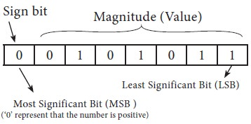

Sign Binary Number
8 bit sign Binary Number: MSB of binary number is used to represent the sign and remaining bits are used for magnitude.
Range of n-bit sign binary number:

Slide 13
Complements
Type of Complements:
  Radix complements (r’s)
  Diminished radix complement (r-1)
  Diminished radix complement (r-1):
  Given a number N in base r having n digits, the (r–1)’s complement of N is defined as: (r ^{n} –1) – N
  Example:
    1’s complement of 1011000 is: 1111111–1011000 = 0100111
    9’s complement of 546700 is 999999–546700 = 453299
  1’s Complement: All ‘0’s become ‘1’s and All ‘1’s become ‘0’s.
  Example:
    1’s Complement of (10110000)2 is (01001111)2.

Slide 14
Complements
Radix Complement (r’s complement):
The r's complement of an n-digit number N in base r is defined as:
( r ^{n} – N) for N ≠ 0 and as 0 for N = 0
The r's complement is obtained by adding 1 to the (r - 1) 's complement,
  Example:
    The 2's complement of 1101100 is 0010100.
    The 10's complement of 012398 is 987602.
  2’s Complement (Radix Complement):Take 1’s complement then add 1 or Toggle all bits to the left of the first ‘1’ from the right.

Slide 15
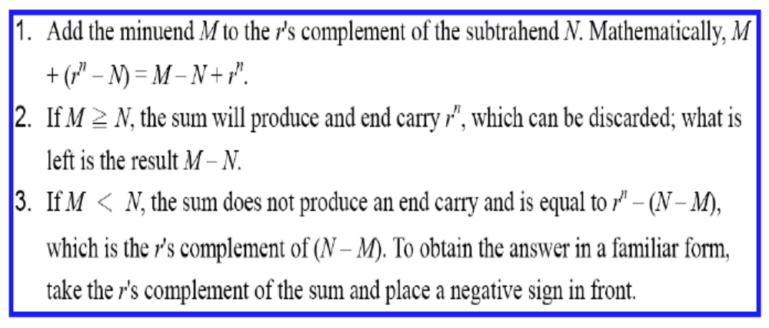
Subtraction using Complements
The subtraction of two n-digit unsigned numbers M – N in base r can be done as follows:

Slide 16
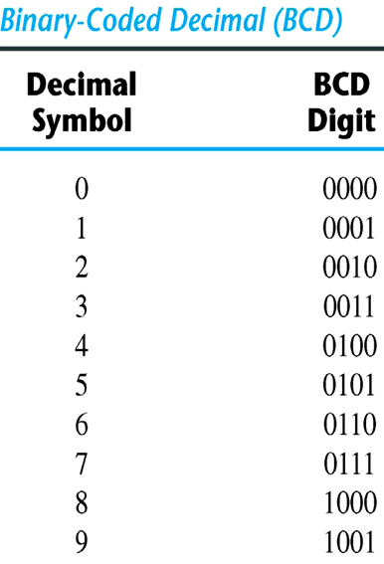
Binary codes
BCD code (Binary coded Decimal):
A number with k decimal digits will require 4k bits in BCD.
Decimal 396 is represented in BCD with 12bits as 0011 1001 0110, with each group of 4 bits representing one decimal digit.
A decimal number in BCD is the same as its equivalent binary number only when the number is between 0 and 9.
The binary combinations 1010 through 1111 are not used and have no meaning in BCD.

Slide 17
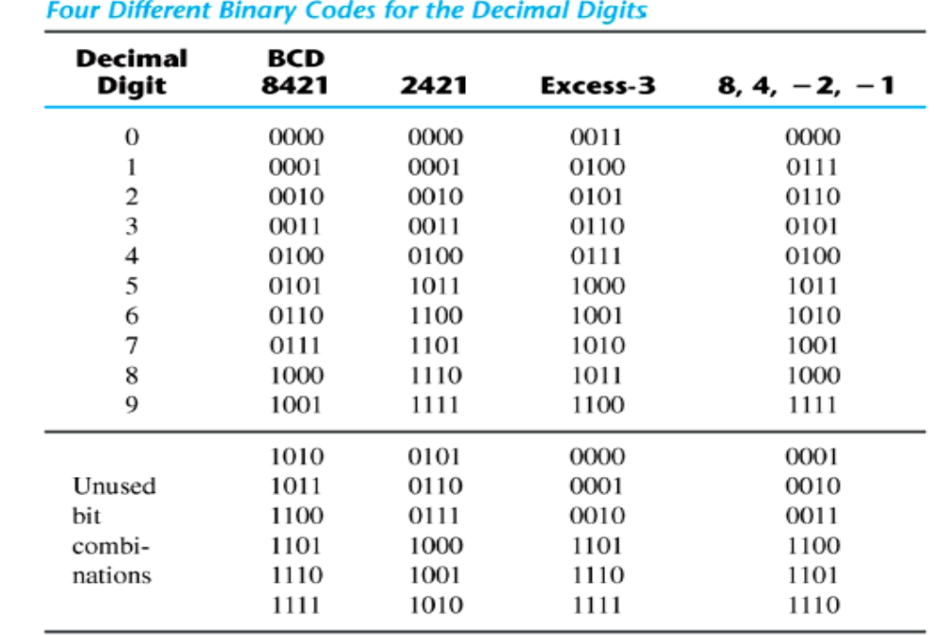
Binary codes
Decimal Codes:

Slide 18
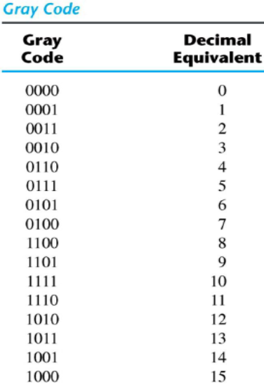
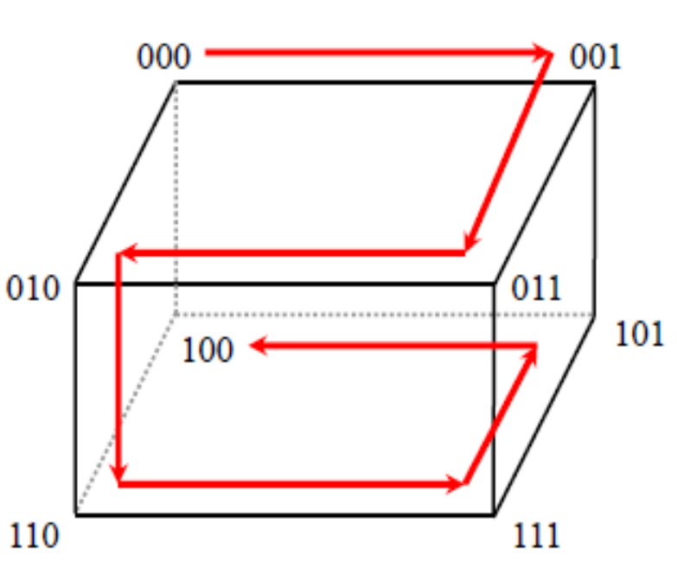
Binary codes
Gray Code:
The advantage is that only bit in the code group changes in going from one number to the next.

Slide 19
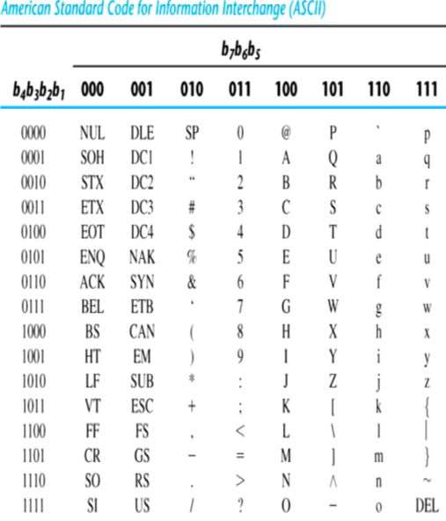
Binary codes
American Standard Code for Information Interchange (ASCII) Code:
It uses 7-bits to represent, 94 Graphic printing characters and 34 Non-printing characters.
Some non-printing characters are used for text format (e.g. BS =Backspace, CR = carriage return).
Other non-printing characters are used for record marking and flow control (e.g. STX and ETX start).
ASCII has some interesting properties:
Digits 0 to 9 span Hexadecimal values 3016 to 3916.
Upper case A-Z span 4116 to 5A16.
Lower case a-z span 6116 to 7A16.

Slide 20
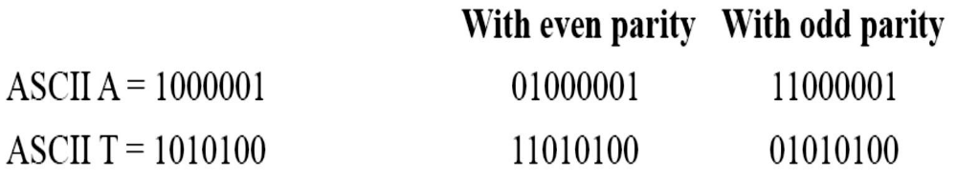
Error-Detecting Code
To detect errors in data communication and processing, an eighth bit is sometimes added to the ASCII character to indicate its parity.
A parity bit is an extra bit included with a message to make the total number of 1's either even or odd.
Example: Consider the following two characters and their even and odd parity.

Slide 21
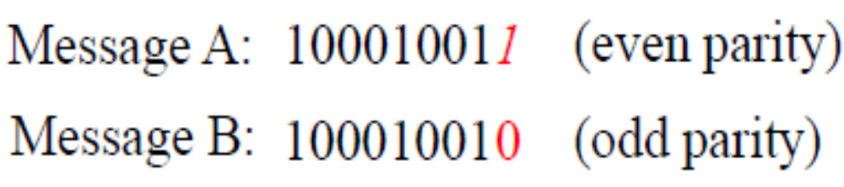
Error-Correcting Code
Redundancy (e.g. extra information), in the form of extra bits, can be incorporated into binary code words to detect and correct errors.
A simple form of redundancy is parity, an extra bit appended onto the code word to make the number of 1’s odd or even. Parity can detect all single bit errors and some multiple-bit errors.
A code word has even parity if the number of 1’s in the code word is even.
A code word has odd parity if the number of 1’s in the code word is odd.
Example:

Slide 22
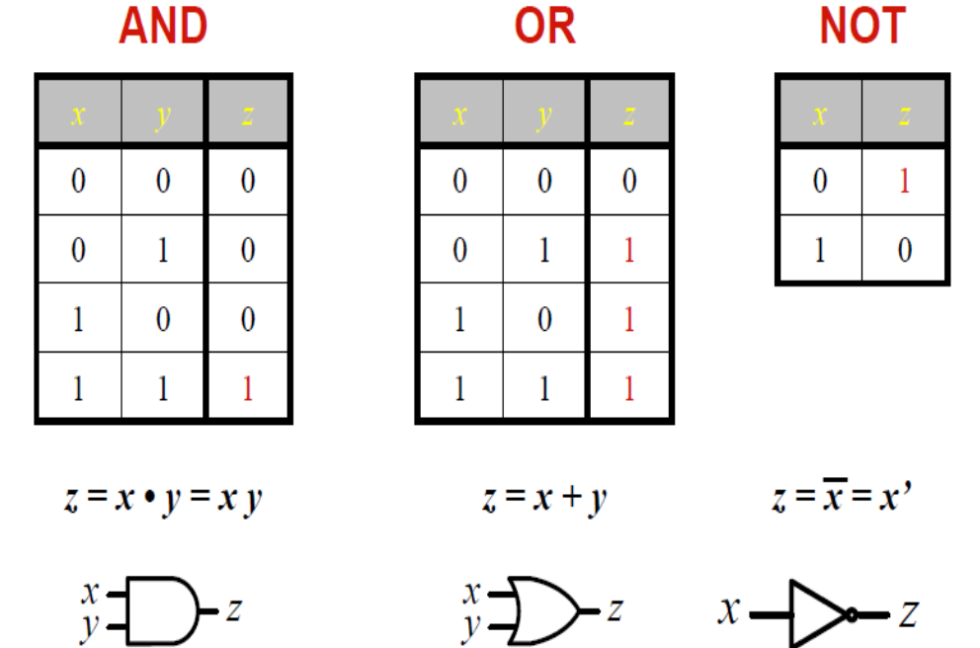
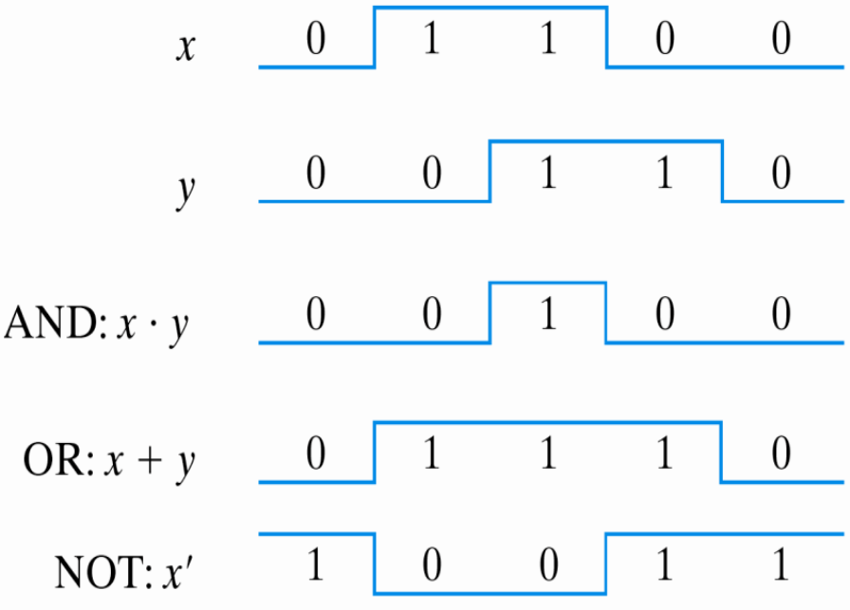
Binary logic
Binary logic consists of binary variables and a set of logical operations.
The variables are designated by letters of the alphabet, such as A, B, C, x, y, z, etc, with each variable having two and only two distinct possible values: 1 and 0.

Slide 23
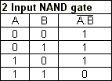
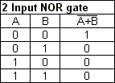
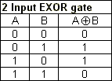
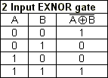




Binary logic
Binary logic consists of binary variables and a set of logical operations.
The variables are designated by letters of the alphabet, such as A, B, C, x, y, z, etc, with each variable having two and only two distinct possible values: 1 and 0.

Slide 24
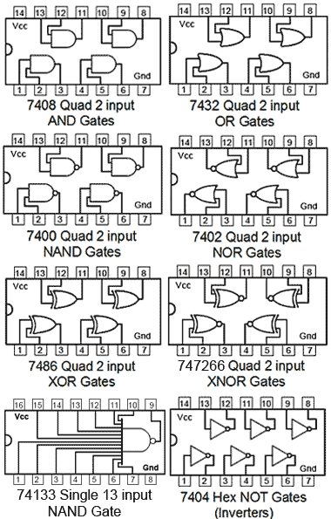
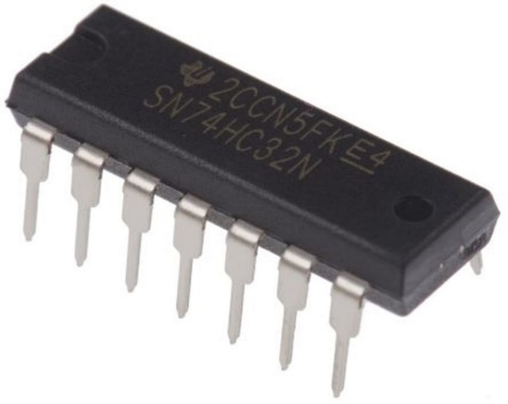
Logic Gates IC
Two Input logic gate IC 74xx series:

Slide 25
Digital Logic Families
Type of Digital Logic Families:
RTL (Resistor-transistor logic)
DTL (Diode-transistor logic)
TTL (Transistor -transistor logic)
ECL (Emitter-coupled logic)
Characteristic of Logic Families:
Logic Levels
Noise margin
Propagation delay
Fan-out
Power Dissipation
Speed-Power Product

Slide 26
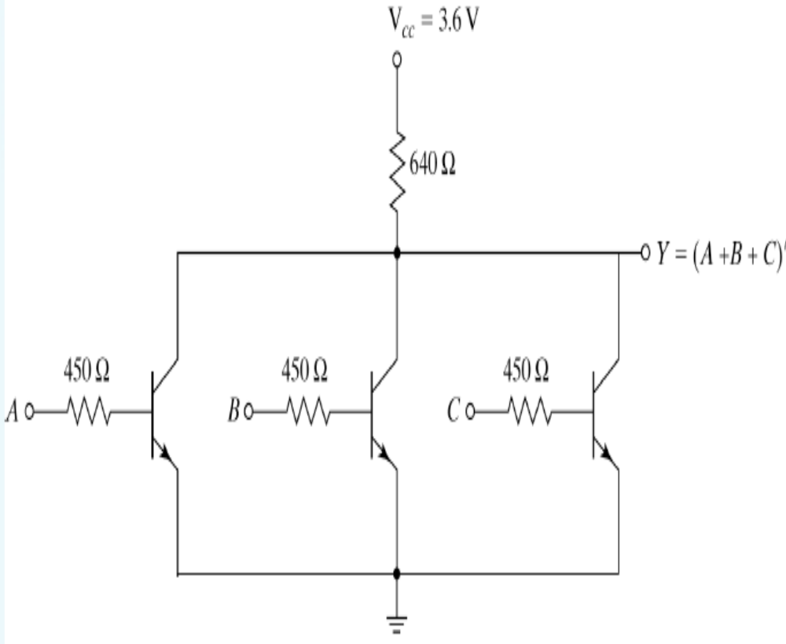
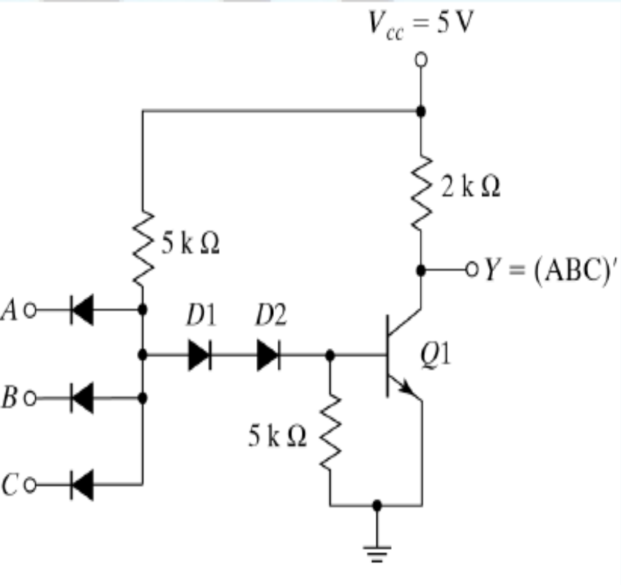
Type of Digital Logic Families
RTL-NOR
DTL-NAND

Slide 27
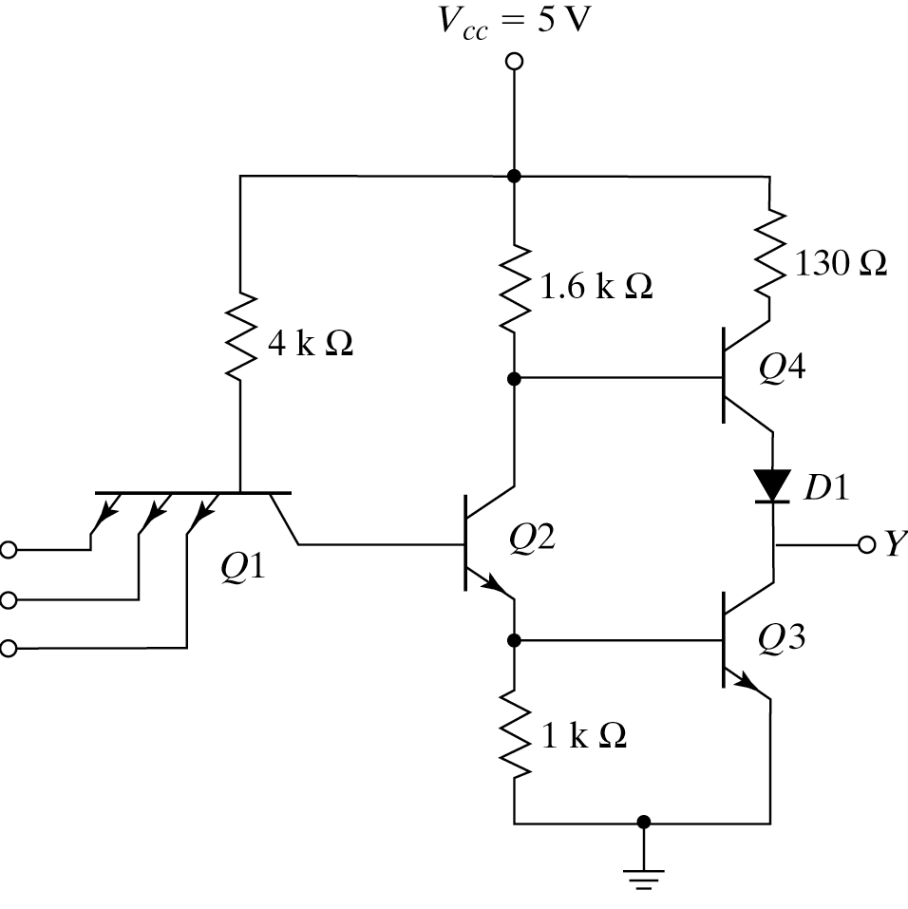
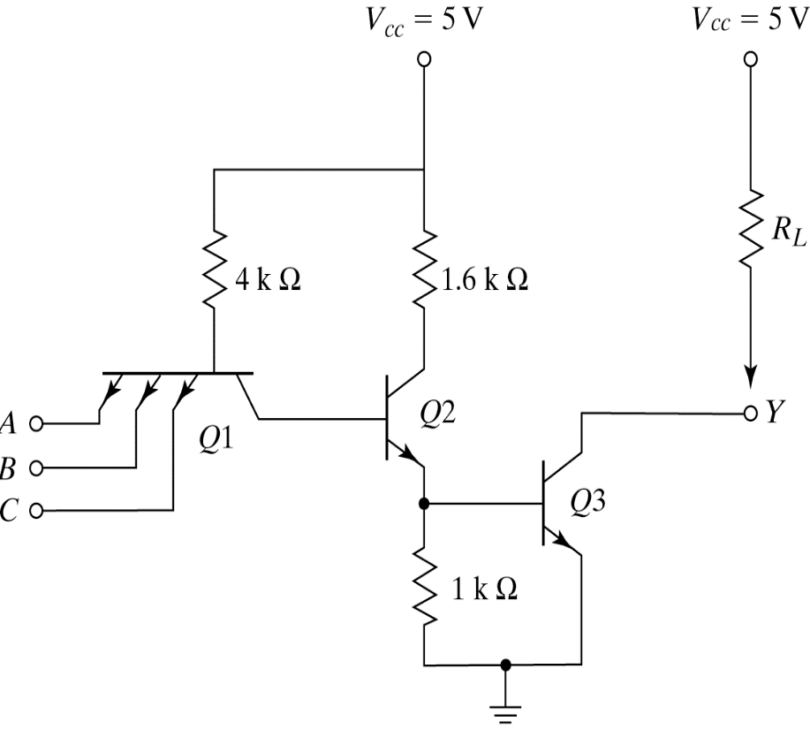
  TTL NAND Gate With Totem-pole Output Open collector TTL NAND Gate
Type of Digital Logic Families
Transistor-Transistor Logic (TTL):

Slide 28
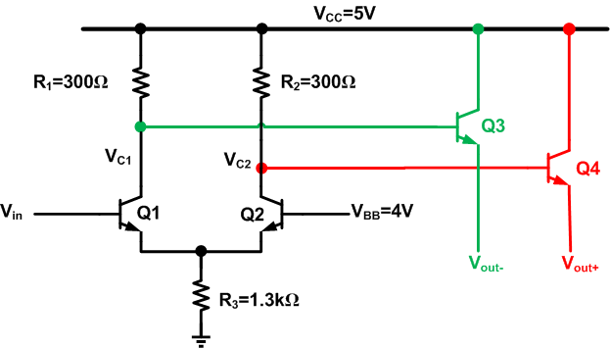
Type of Digital Logic Families
EMITTER-COUPLED LOGIC (ECL):

Slide 29


www.paruluniversity.ac.in

